Slide 1
Today’s Topics
Weekly links
Homework Review
Stephen Few’s Now You See It, Ch 1-2, Review
Big Data’s and its impact on data visualization
Cloud services
Cloud’s impact on visualization
Visualization in the cloud

Slide 2
Links this week
Simple, clean informative, context about Presidential Primaries from 538:
http://fivethirtyeight.com/features/the-presidential-race-is-finally-moving-to-states-with-economic-problems-2/
And another from 538, similar to our analysis of party campaign contributions
http://fivethirtyeight.com/features/republican-leaning-cities-are-at-greater-risk-of-job-automation/
Robert Kosara (twitter.com/eagereyes) talking about information visualization:
https://eagereyes.org/blog/2016/the-state-of-information-visualization-2016
One of Robert’s links went here. Very creative and cool!
http://www.dear-data.com/all
Darwin’s Origin of the Species revisions
http://fathom.info/traces
Learning D3.js
https://medium.com/@enjalot/how-do-you-learn-d3-js-ccffc151419b#.ltz1i2uty

Slide 3
Homework Last Week
Laura – graduation rates and $/pupil. Clean, simple, informative.
https://public.tableau.com/profile/publish/Assignment5-AmountSpentPerPupil-GraduationRate/Dashboard4
Richard – Florida vs Washington analysis is always amusing. Basing things on “monthly” is a great.
http://www.caucapino4u.com/2016/02/engineering-salaries-cost-of-1-bedroom.html
Katherine – Rent as percentage of income (especially relevant with the Yelp story this week)
https://public.tableau.com/profile/publish/The30Percent-of-IncomeRuleinSeattle/Dashboard1#!/publish-confirm
Amelia – education, wages, states, regions. Colorful, interesting, informative
https://public.tableau.com/profile/amelia.kohm#!/vizhome/Mash_UpCensusandBLSdata/Dashboard2
Aleksei – There are 3,300 counties in the U.S. but look at how many make of 50% of the income. https://public.tableau.com/profile/aleksey.kramer#!/vizhome/TaxableSalariesPerCounty/TaxableSalariesperCounty
Keith – affordability by state – Good use of colors, and many data series.
https://public.tableau.com/profile/keith.m.#!/vizhome/mashup/Dashboard1
Albert – Apple earnings vs share price
https://public.tableau.com/profile/prescott.pettiette4312#!/vizhome/ComparisonofApplesStockPricesandEPSfrom2006-2015/Sheet1

Slide 4
Homework: Opportunities to Improve
Labels become more critical as more data is presented
When combining two types of data, think about their relationship and if it’s possible to actually present that relationship (scatter, ratio)
When comparing things like salary and rent, ideally use the same time span (likely monthly)
When comparing a dimension, like two cities, make sure the two things can be easily compared, rather than relying on the viewer’s memory.
If you ask a question in your title, try to make the answer very clear.
Always have units. Especially if your data is 1000s or millions, etc
Don’t use two visualization attributes to represent one metric.

Slide 5

Stephen Few
Now You See It (Ch 1, 2)

Slide 6
About Stephen Few
Book highlights:
Information Dashboard Design: Displaying data for at-a-glance monitoring, Analytics Press, 2013
Show Me the Numbers: Designing Tables and Graphs to Enlighten, Analytics Press, 2012
Now You See It: Simple Visualization Techniques for Quantitative Analysis, Analytics Press, 2009
Website: http://www.perceptualedge.com/
Offers multiple visualization courses around the world
Involved in controversy lately for his criticisms of academia

Slide 7
Few’s Definition of Information Visualization
Computer supported – displayed on a computer screen
Interactive – filtering, drilling down
Visual representations – location, shape, color
Abstract data – quantitative data, processes, relationships
Amplify cognition – extend our ability to think about data

Slide 8
Chapter 1: Information Visualization
A brief history of visualization from the earliest tabular information to the work of Playfair, Bertin, Tukey, Tufte, and Cleveland.
“As the flood of data threatens to drown us, it is time to develop the fundamental and simple skills that will make data analysis easier and more effective”

Slide 9
Chapter 2: Traits of effective analysts
Curious
Open-Minded
Imaginative
Skeptical
Know what’s worthwhile
Methodical
Analytical
Synthetical
Familiar with the data
Skilled in data analysis

Slide 10
Chapter 2: Traits of meaningful data
High volume
Historical
Consistent
Multivariate
Atomic
Clean
Clear
Dimensionally structured
Richly segmented
Of known pedigree
(Bold is big data)

Slide 11
Big Data
Weather or Not

Slide 12
Gartner’s Definition of Big Data
Big data is high-volume, high-velocity and/or high-variety information assets that demand cost-effective, innovative forms of information processing that enable enhanced insight, decision making, and process automation.

Slide 13
Visualization Meets Big Data
Visualization helps to analyze and understand high-volume, high-velocity and/or high-variety information assets. Visualizations are innovative forms of information processing that enable enhanced insight, decision making, and process automation.

Slide 14
Big data examples
Web traffic logs
App usage logs
Weather sensor data
Amazon orders
Boeing simulation data
Facebook user relationships
Netflix movie ratings
Residential home prices and characteristics
Human genome
Seismic sensor data

Slide 15
Wunderground Big Data
From the bolded part of Few’s Meaningful Data, big data is:
High volume – 180,000 weather stations
Historical data – 1 data point/2.5 sec for a year ~ 1.3 million
Many variables – (temp, wind speed/direction, pressure) ~ 10
Multiplied out: 180,000 * 1.3 million * 10 =
2,300,000,000,000 (2.3 trillion) data points or about
10 Terabytes of data
https://www.wunderground.com/weatherstation/overview.asp
https://www.wunderground.com/about/data.asp

Slide 16
Wunderground Big Data
This “big data” could fit on a single hard drive*
But, the hard part:
Analyzing the data could take minutes to years
(reading 10TB of data from a single hard drive would take 13 hours)
No standard way to visualize big data
“Innovative forms” of information processing require all of the “traits of effective analysts” and more.
* This hard drive costs $2,000

Slide 17
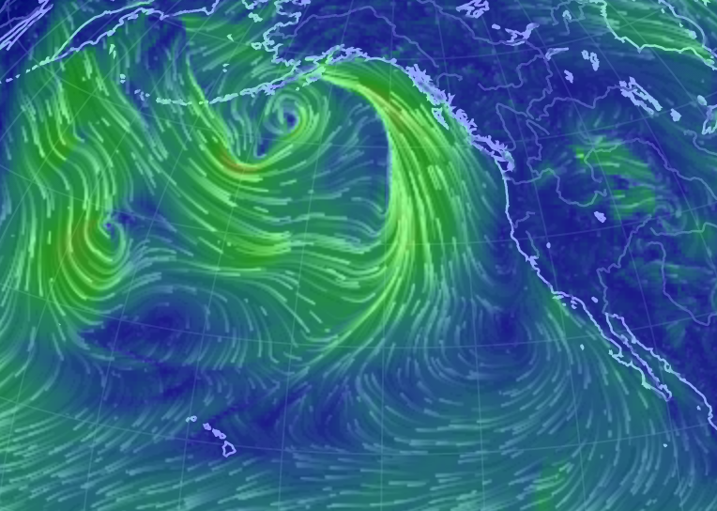
Visualizing Weather: Earth wind map
Earth wind map
Big data?
Just roughly one moment in time (although can look at more)
As time range changes, data aggregates.
Data ~ 100,000 data points?

Slide 18
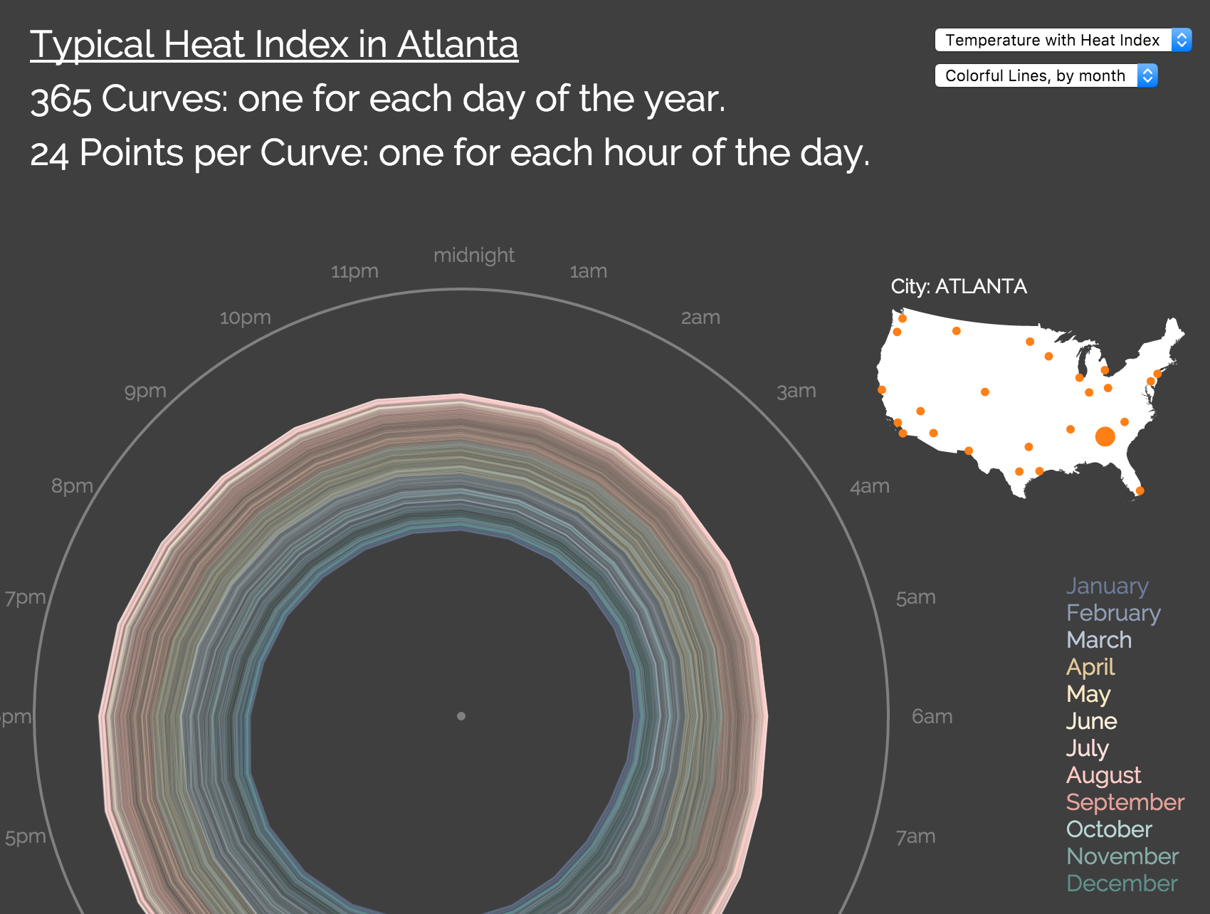
Visualizing Weather: Weather patterns
Weather Patterns
Big data?
365 days and 24 hours a day, averages
But what about current points or points for a given year?
Data ~ 9,000 data points

Slide 19
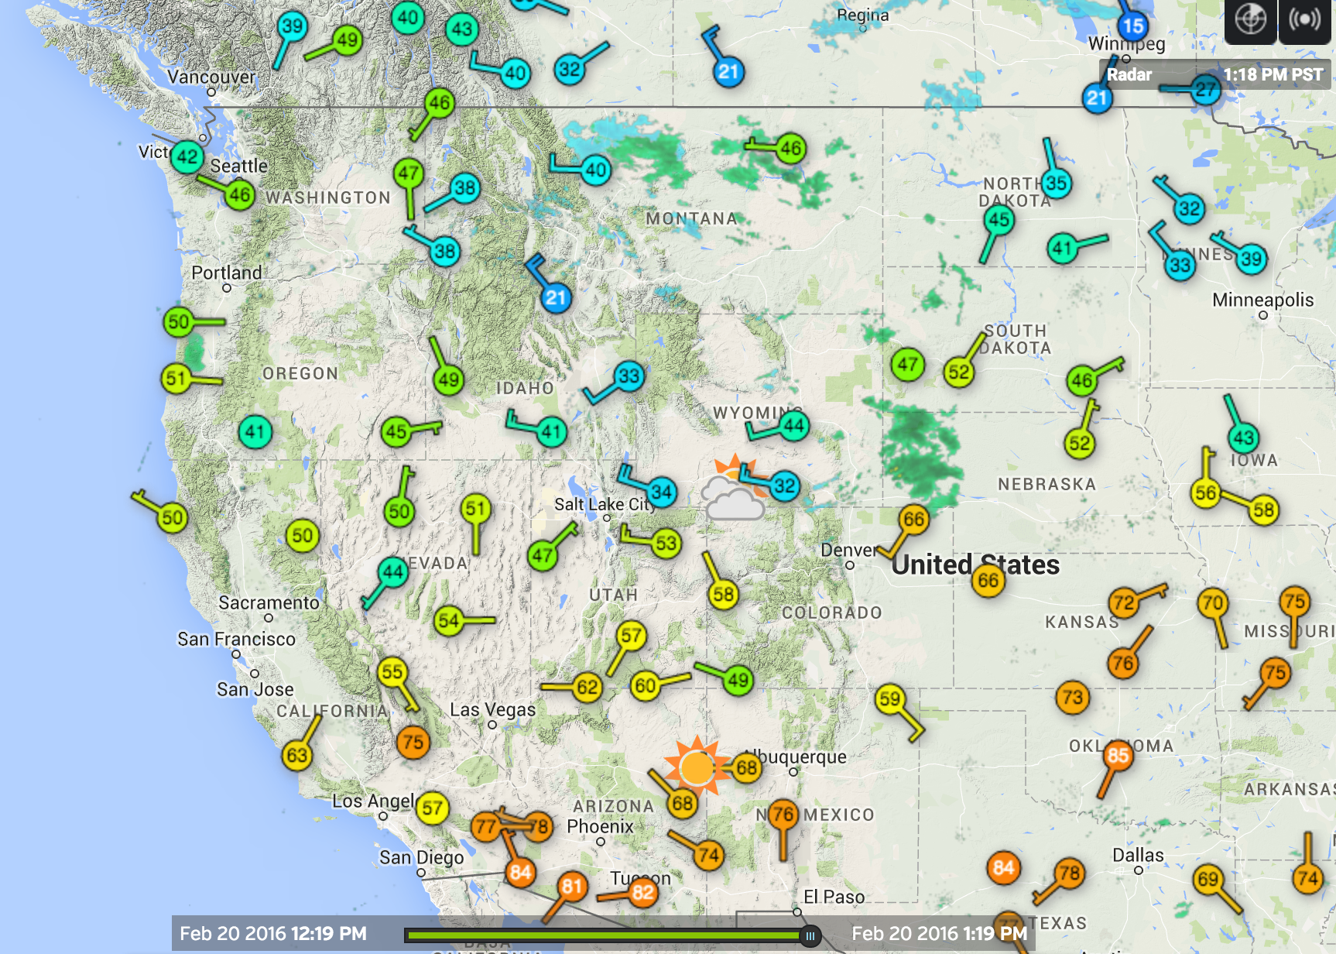
Visualizing Weather: Earth wind map
Wunderground map
Big data?
Single point in time
Just a few cities
Data ~ 500 data points

Slide 20
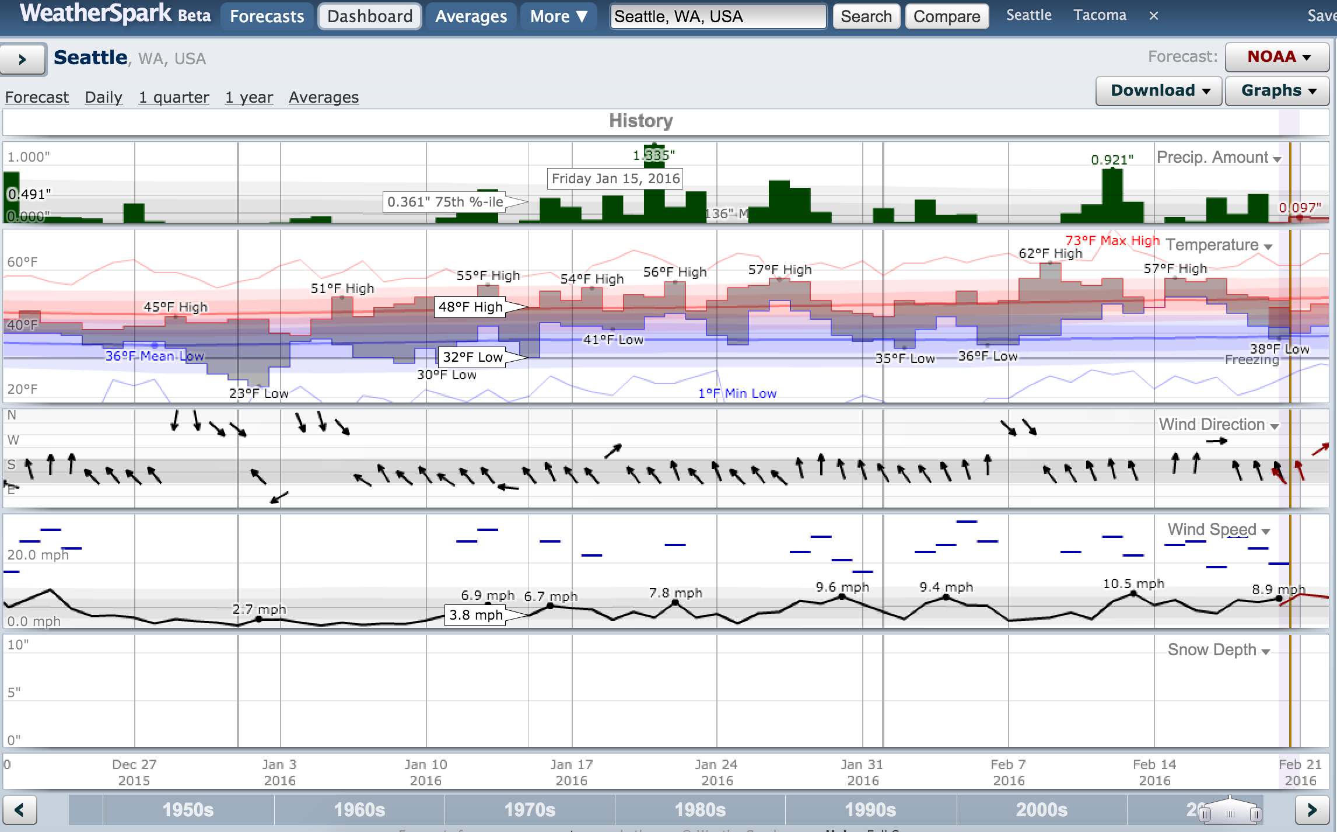
Visualizing Weather: Weatherspark
Weather Spark
Big data?
Only one location.
As time range changes, data aggregates.
90 days * 25 metrics ~ 250 data points

Slide 21
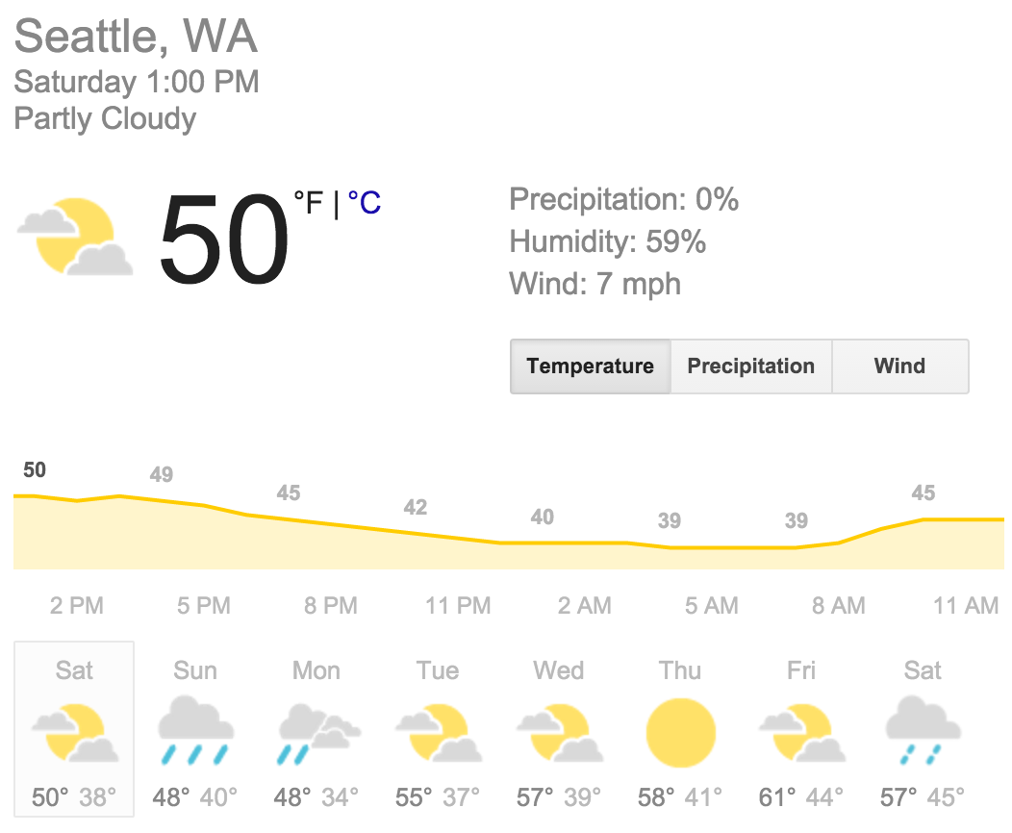
Visualizing Weather: Google forecast
Earth wind map
Big data?
This is really what most weather data is about. Forecasts
Data ~ 30 data points

Slide 22
Visualization Meets Big Data
Typical computer screen: 2,000 x 1,000 = 2 million pixels
Typical smartphone screen: 600,000 pixels
Imagine a two million pixels, or 2 megapixels

Slide 24


Slide 25
Visualization Meets Big Data
How much can did you take away from the last two photos?
1 thing, 5 things, 10 things?

Slide 26
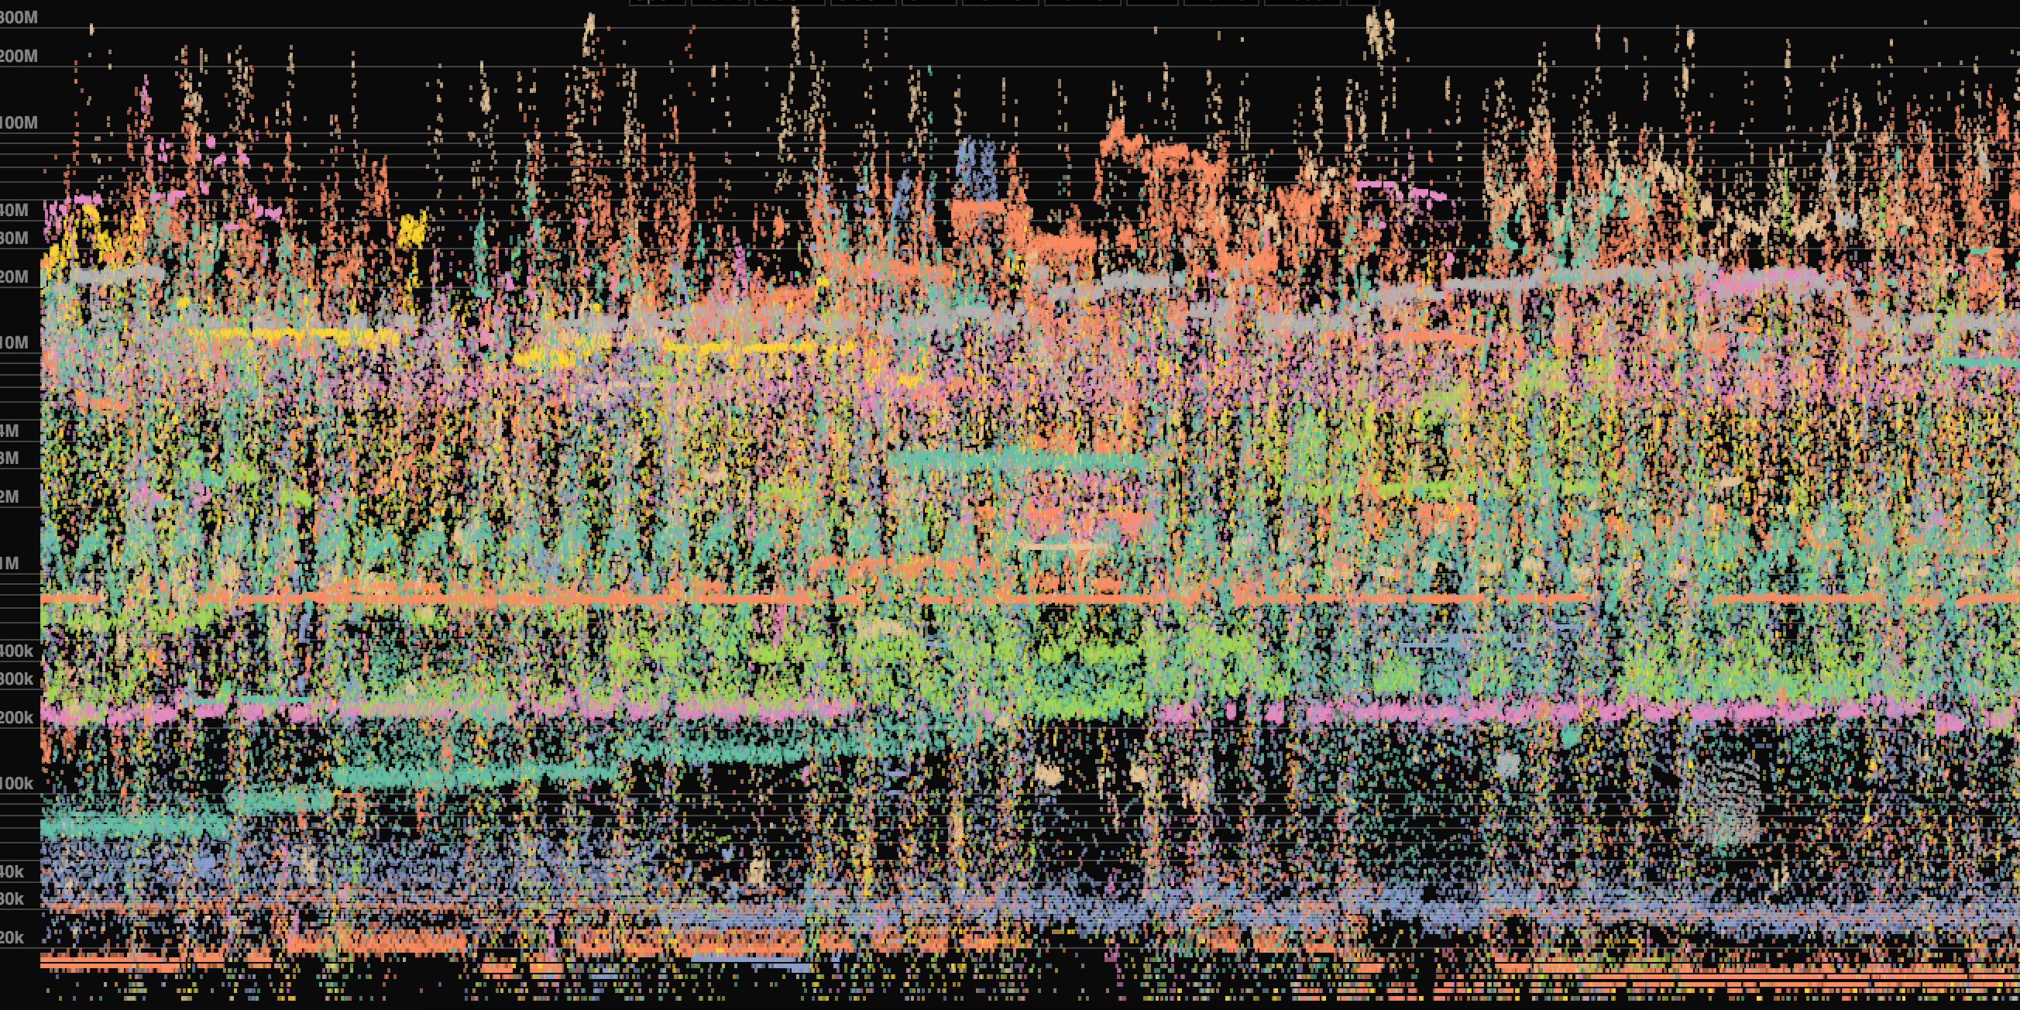
Big data -> big mess
~350,000 data points

Slide 27
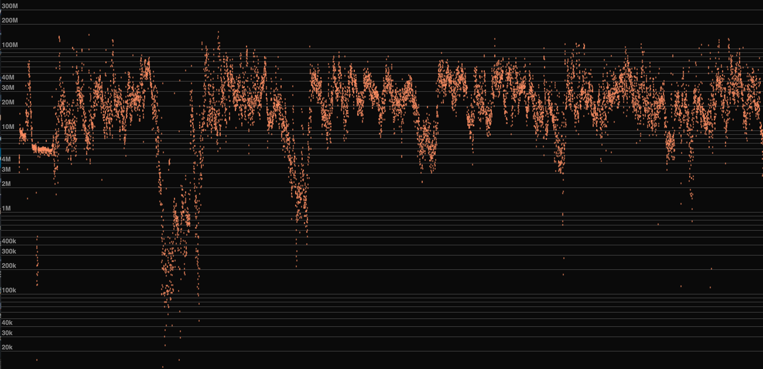
Reduce dimensions -> manageable
Still ~10,000 data points

Slide 28
Visualization Meets Big Data
Many “little data” strategies work (or are required) for big data:
Aggregate time
Filtering
Reduce dimensions
Find/highlight outliers
Allow drilldown
Have an idea of what you’re looking for

Slide 29
The Cloud
&
Big Data Platforms

Slide 30
What is the Cloud? (A cynical take)

Slide 31
So everything is the cloud? Pretty much
With the proliferation of internet, PCs, tablets, smart phones, “the cloud” is hear to stay.

Slide 32
What is the Cloud?
The cloud is hosted hardware, software and services that allow someone to solve small to very big problems with limited upfront investment and less need to manage infrastructure.

Slide 33
What is the Cloud?
Cloud-Based Services
Uber, Netflix, Salesforce, Ebay, Facebook, Snapchat, Twitter,
local to federal governments …
Basically every company
Cloud Platform (Infrastructure) Solutions
Microsoft Azure
Amazon Web Services
Google Cloud Platform
Big-data Storage & Computing Platforms
Hadoop, Spark, Couchbase, MongoDB, Hbase, MySQL, PostgreSQL, Oracle, SQL Server, Amazon, Splunk

Slide 34
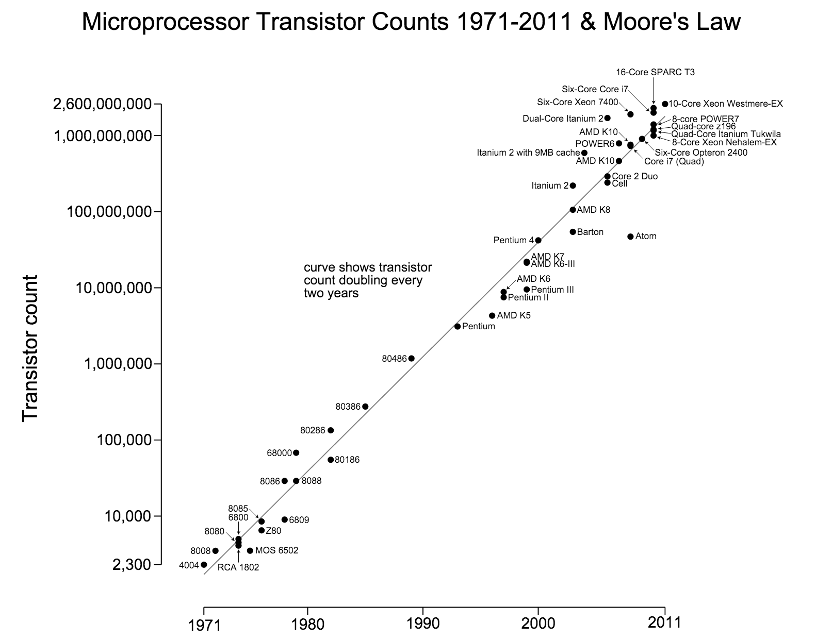
Hardware: The Cloud helps deal with constantly improving and changing technology

Slide 35
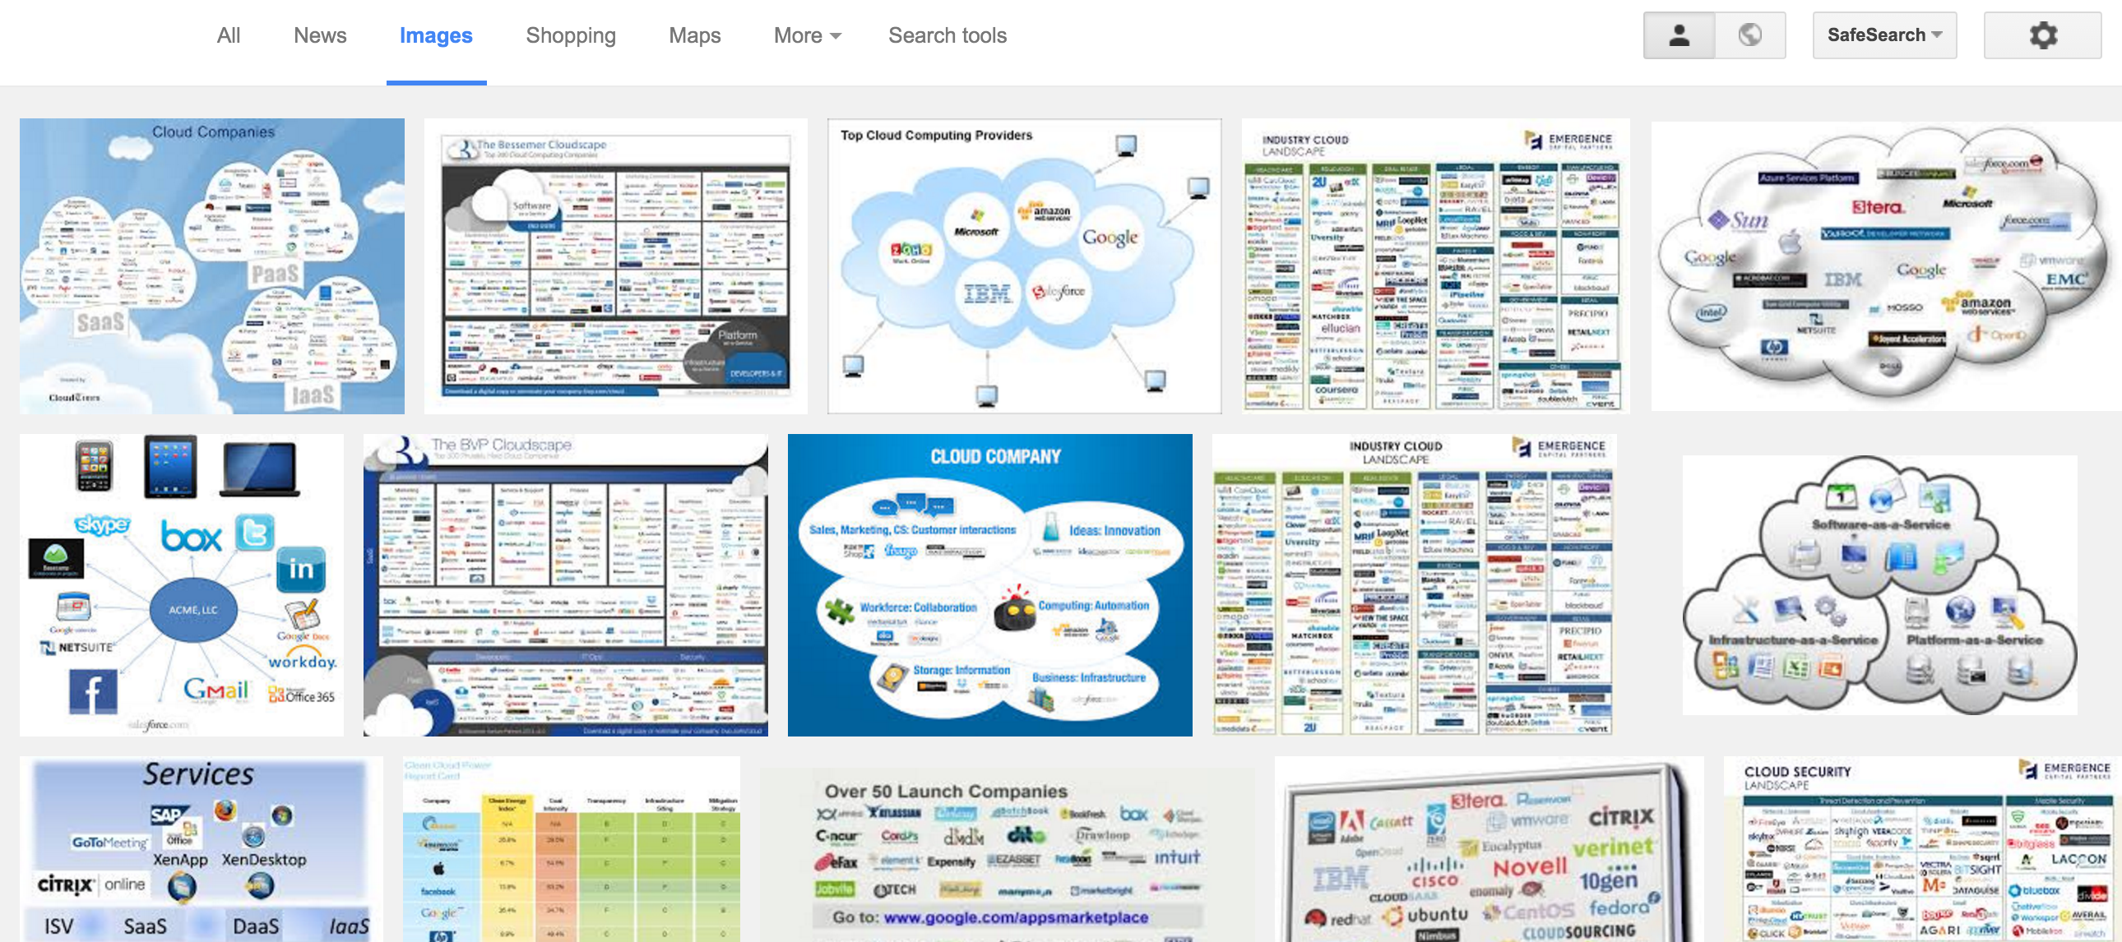
Google image search for “Cloud Companies”

Slide 36
What about Cloud Visualization?
Still in the very early stages, no clear leader.
Tableau Public
Microsoft PowerBI
Plotly
D3.js (it’s more of a programming language)
Amazon Quicksight (literally early stages)
Quadrigram (just a small startup)

Slide 37
What’s hard with Cloud Visualization?
Setup, cleansing, and exploration of data.
Transferring large amounts of data over the internet.
Fast, desktop-like interaction.

Slide 38
The future of Cloud Visualization?
Look out for solutions from the big players: Microsoft, Google, Amazon, Oracle, IBM, etc.
Keep watching, and trying out new technologies

Slide 39
Cloud Links
https://azure.microsoft.com/en-us/documentation/scenarios/data-analytics/
https://aws.amazon.com/products/
https://cloud.google.com/
http://projects-old.apache.org/indexes/category.html#big-data

Slide 40
Homework

